Slide 1

Fundamentals of Information Security SEC285
Final Project

Slide 2
Introduction
This list shows the learning objectives of individual modules for the course.
At the end there are additional challenges completed from some modules.
Module tasks | Page numbers
Build A Light Control System | 3 to 4
Vulnerability Assessment | 5 to 9
Stateful Firewall and Multi-factor Authentication | 10 to 12
Bring Your Own Device Security Policy | 13 to 17
Build a home security system with alarms | 18 to 21
Asymmetric Key File Encryption | 22 to 24
Conclusion, Challenges, Career Skills Obtained | 25 to 30

Slide 3
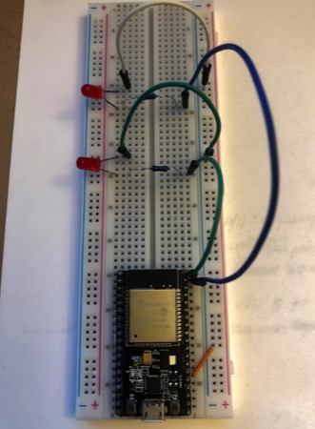
This is a 2-light Breadboard Layout that will be used to run a lighting system control remotely from a phone or computer browser via an URL
Build A Light Control System
The picture show:
ESP32
Two LEDs
Two Resistors
Wires

Slide 4
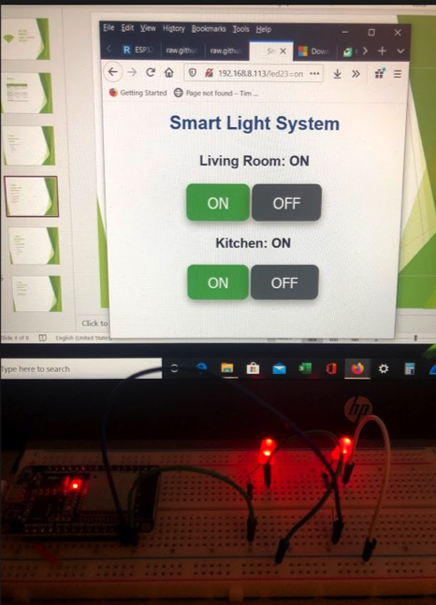
2-light Control Web Interface
The screenshot shows:
1. two sets of buttons to control two lights.
2. both lights being switched on.
3. IP address in the browser URL.
The lights are turned on and off using the computer browser shown in the photo.

Slide 5
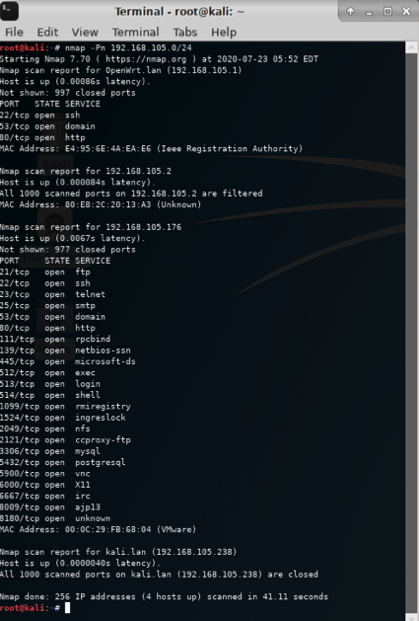
Vulnerability Assessment
NMAP Scan
Module 2
Running NMAP
to do Port Scanning on different
virtual machines.
Purpose is to find ports that are opened to exploit and connect to the virtual machines or the host.
Next 3 slides are to show using Nessus Essentials to scan Metasploitable virtual machine and understand the levels of severity of the found vulnerabilities.
Host IP
Linux-Server VM IP
Kali VM IP

Slide 6
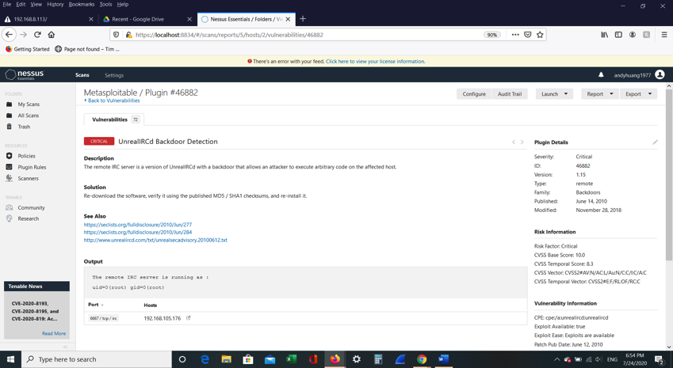
A vulnerability of Critical severity rating
Plugin name: | UnrealRCd Backdoor Detection
Risk factor: | Critical (RED color)
Other info: | Published on 6/14/2010, report also describes how the vulnerability works by attacker execute codes on affected hosts and provide solution.

Slide 7
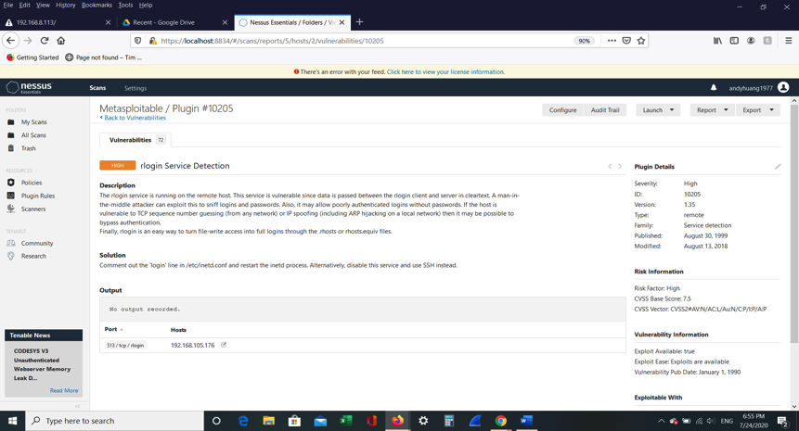
A vulnerability of
High severity rating
Plugin name: | rlogin Service Detection
Risk factor: | Critical (Orange color)
Other info: | Published on 8/30/1999, report also describes how the vulnerability works as man-in-the-middle attack to sniff the clear text connections between client and server and provide solution.

Slide 8
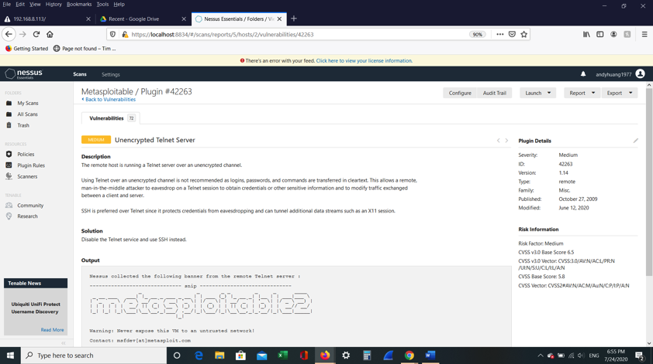
A vulnerability of
Medium severity rating
Plugin name: | Unencrypted Telnet Server
Risk factor: | Critical (Yellow color)
Other info: | Published on 10/27/2009, report also describes how the vulnerability works as the remote host is running a Telnet server over an unencrypted channel and provide solution.

Slide 9
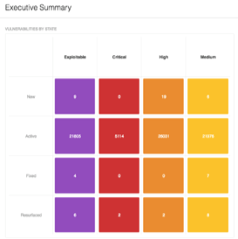
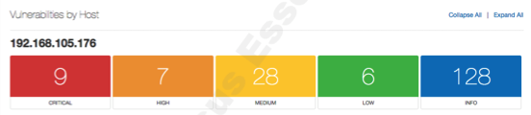
Questions
What is the significance of ranking the vulnerabilities by severity level?
Nessus scans for a wide variety of vulnerabilities in websites, web applications and web services. Its automation makes it easy to scan websites and prioritizes the findings, helping you decide which ones to tackle first, based on defining acceptable risks from a corporate point of view.
The issues marked as Critical Severity can allow attackers to execute code on the web application or application server, or access sensitive data.
Compares to Critical and High Severity levels, special conditions are required to exploit Medium Severity issues and they don't directly affect the application or system, in order to keep your web application secure and comply with the regulations, they should still be fixed.
What is the significance of the Executive Summary in the Nessus Essentials report?
Executive Summary provides a summary for executives to review quickly for any new emerging trend on the rise over time. Executives are often pummeled with information from many different sources, one of those sources being vulnerability management. This dashboard takes into account all the metrics available to Tenable customers and helps to narrow the search down to only a few key metrics like severity, Common Vulnerabilities and Exposures (CVE) identifier, and vulnerability state.

Slide 10
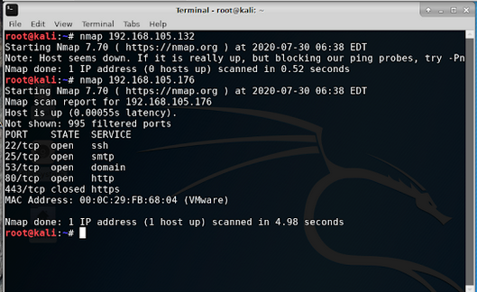
Stateful Firewall
Use IPTABLES To Restrict Port Access
This is NMAP scan result after configured IP Tables to close used ports to minimize the attack surface.
The screenshot shows a small number of open ports when comparing to the slide 5 that there were more than 5 ports opened.

Slide 11
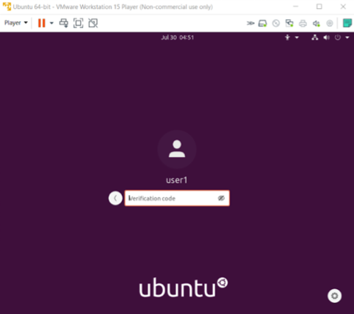
Multi-factor Authentication
The screenshot shows the prompt for the verification code.
By incorporating Google Authenticator this provides multi-factor authentication. In case the password is compromised.

Slide 12
Questions
1) In what practical use case would the command sudo iptables --policy INPUT DROP be used? What effect does this command have on access to computing resources?
The command “Iptables –P INPUT DROP” sets the default policy for all INPUT chain to drop(discard) all packets.
These commands control the flow of the traffic to the computing resources and the exercise shows that Kali can’t scan the ports of the Metasploitable server when the incoming packets are dropped.
2) What is the difference between iptables -A and iptables -I? When would you use the -A option as opposed to the -I option?
-A is append option and –I is insert option.
iptables -A appends rules at the end of the ruleset whereas iptables -I inserts the rule at a specific position in the ruleset.

Slide 13
Overview section of the security policy
This module is to research and create a
Bring Your Own Device (BYOD) Security Policy
People at Total Jerk tend to look at mobile security threats as an all-encompassing threat. But the truth is, there are different types of mobile security threats to be aware of. We will first define a list of devices that will possibly be used for work involving those threats and address what those threats are in the next section.
Smartphones – iPhones and Android
Other mobile/cellular phones – Old generation flip phones
Tablet computers – iPad, Windows tablet Dell Venue Pro, Android tablets
Portable media devices – USB stick or portable hard drives
Personal Digital Assistance (PDA) - Blackberry
Ultra-mobile PCs (UMPCs) - Microsoft Surface
Laptop/notebook computers, including home desktops
Any personally-owned device capable of storing organizational data and connecting to a network
This BYOD security policy applies to any hardware and related software that is not organizationally owned or supplied, but could be used to access organizational resources. That is, devices that employees have acquired for personal use but also wish to use in the business environment.

Slide 14
Purpose section of the security policy
The purpose of this policy intends to prevent data from being deliberately or inadvertently stored insecurely on a device or carried over an insecure network where it could potentially be accessed by unsanctioned resources. A breach of this type could result in loss of information, damage to critical applications, loss of revenue, and damage to the company’s public image.
We will define some of the threats to explain why BYOD is important. They include application-based, web-based, network-based and physical threats.
Here's how they work:
Application-based threats happen when people download apps that look legit but actually skim data from their device. Examples are spyware and malware that steal personal and business information without people realizing what's going on.
Solution: Install anti-spyware before using the apps.
Web-based threats are subtle and tend to go unnoticed. They happen when people visit affected sites that seem fine on the front-end but in reality, automatically download malicious content onto devices.
Solution: Although similar to the application threats but install anti-malware that does website malware scan will greatly reduce possibility of client script from being auto executed to download malicious contents.
Network-based threats are especially bad because cybercriminals can steal unencrypted data while people use public WiFi networks.
Solution: Use VPN to create secure tunnel connection to encrypt transmission of data using unsecure WiFi networks.
Physical threats happen when someone loses their mobile device or has it stolen. Because hackers have direct access to the hardware where private data is stored or where they have access to data, this threat is especially dangerous to enterprises.
Solution: Install a mobile device management system on the devices to remotely wipe devices, encrypt devices, use secure VPN, and locate devices if the devices are lost or stolen.
Bring your own disasters often involve combination of these types of threats.

Slide 15
Scope section of the security policy
This policy applies to all Total Jerk employees, including full and part-time staff, contractors, freelancers, and other agents who use a personally-owned device to access, store, back up, or relocate any organization or client-specific data. Such access to this confidential data is a privilege, not a right, and forms the basis of the trust Total Jerk has built with its clients, supply chain partners, and other constituents. Consequently, employment at Total Jerk does not automatically guarantee the initial or ongoing ability to use these devices to gain access to organizational networks and information.
The Chief of Security Officer has delegated the execution and maintenance of information technology and information systems to the individual manager to track their subordinates’ access to company resource. Such as but not limited to user ID to connect to network and mobile number provided by company for daily business uses.
Employee owned devices are not allowed to store any company proprietary network info such as network ID or server location or equipment model or access code, etc. Storing customer personal identifiable info is prohibited, such as SSN as example.
Connectivity of all employee-owned devices will be centrally managed by Total Jerk’s IT department and will use multi-factor authentication and strong encryption measures or alternative compensating controls to isolate and protect any organizational data accessed from or stored on the device where appropriate. Although IT will not directly manage personal devices, end users are expected to adhere to the same security protocols when connected to non-organizational equipment. Failure to do so will result in immediate suspension of all network access privileges so as to protect the company’s infrastructure.

Slide 16
Policy section of the security policy
There are minimum requirements to use employee own equipment to connect to Total Jerk network in order to carry out daily works. Those requirements and compliance rules are defined in this section.
System software minimum requirements are Windows 10 Professional Edition and has up to date security patches installed and RSA SecurID Tokens app installed either on the phone or the computer in order to successfully validate the connection through a token code as part of multi factors authentication. An anti malware from either Norton or McFee installed on the computer connects to the company network is also required.
To connect to the network from home employee’s home router should have firewall enabled as part of hardware requirement.
Consult your manager or the IT handbook provided by IT department to for any remediation if suspecting any sign of possible physical damage to employee equipment while connecting to company network. Employee is responsible for general maintenance of the their own devices. In the case of maintenance period that render devices unusable, company IT will provide the employee with a business-owned device [laptop, desktop, thin client] for the duration of the maintenance period.

Slide 17
Questions
In what way does risk assessment impact the development of Program (security) Policies?
When doing risk assessments a company will have to identify and prioritize the assets based on threat levels in order to develop the security policies.
Quantifiable elements or assets of impact are those on revenues, profits, cost, service levels, regulations and reputation.
Then identify vulnerabilities and analyze available controls to mitigate the risk in order to have sound security policies. Therefore the more risks are discovered the more security policies will be implemented to mitigate those risks or threats.
When is it appropriate to review an organization's Issue-specific (security) Policy?
To provide a common understanding of the purposes for which an employee can and cannot use the organization’s technology or resources.

Slide 18
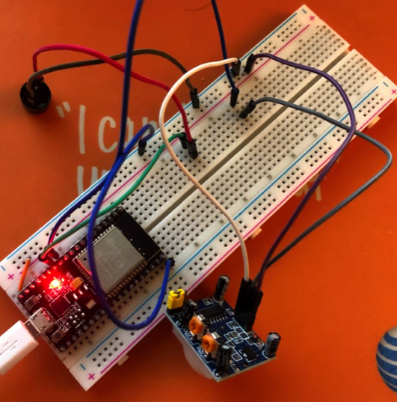
Home Security System
Passive buzzer breadboard layout
The picture shows:
ESP32
Passive buzzer
Motion sensor
Wires
This exercise is to use the motion sensor to trigger passive buzzer to make sound or vibrate as an alarm.

Slide 19
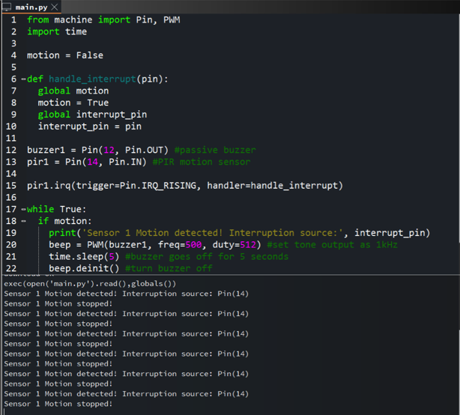
Passive buzzer system output
The screenshot show:
1. “Motion detected” message
2. Interruption source
3. “Motion stopped” message
This is the code used for the system to work. The output window on the bottom indicates the motion is detected by the sensor and triggered the buzzer.

Slide 20
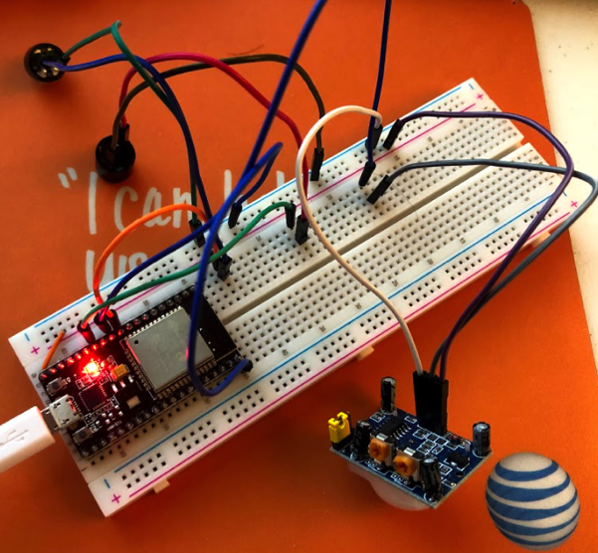
Active buzzer breadboard layout
The picture should show:
ESP32
Passive buzzer
Active buzzer
Motion sensor
Wires
This exercise uses both active and passive buzzer as alarm when motion sensor detects the motion.

Slide 21
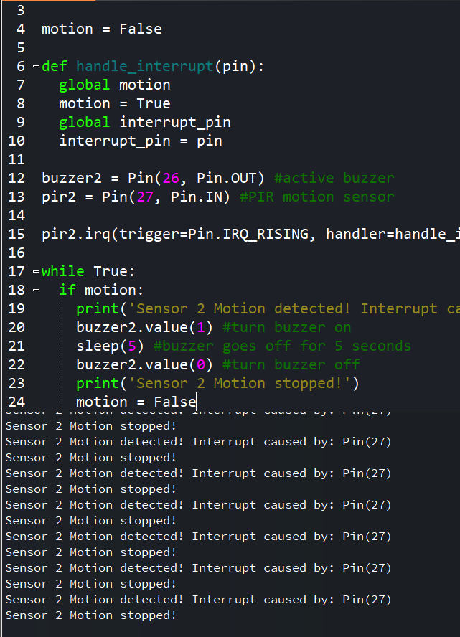
Active buzzer system output
The screenshot should show:
1. “Motion detected” message
2. Interruption source
3. “Motion stopped” message
This is the code to run the alarm system using 2 buzzers. Output window also shows the motion detected and alarm buzzer triggered.

Slide 22
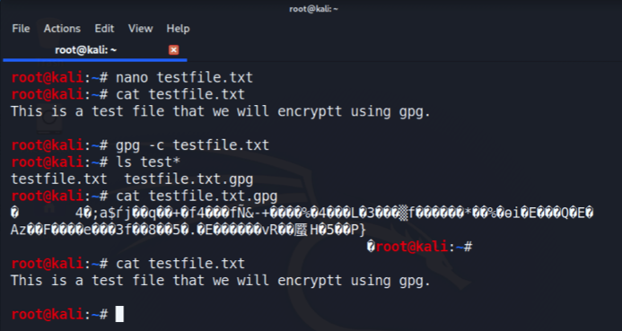
Asymmetric Key
File Encryption
The screenshot show:
content of the plaintext file
content of the encrypted file
This exercise uses the GPG tool to encrypt the plain text file and show
the content of the encrypted file testfile.txt.gpg is not readable.

Slide 23
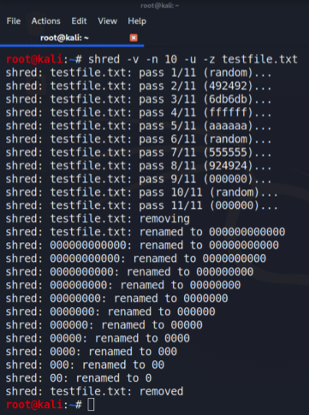
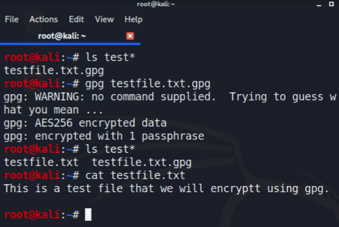
File decryption
The screenshot show:
1. the single encrypted file being listed
2. the decrypting process
3. both the encrypted file and the original plaintext file being listed.
Right image shows that GPG tool decrypts the file and also the content of the decrypted file is readable.
Left image shows the process of shredding a file digitally.

Slide 24
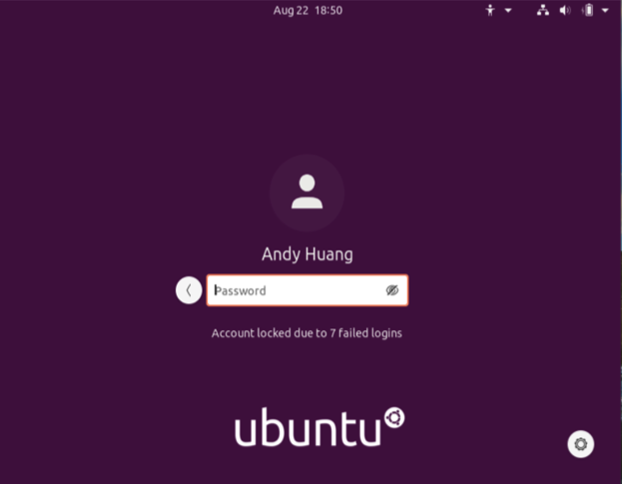
Password Policy Enforcement
Account lockout screen
The screenshot show the “Account locked out due to x failed logins” message.
This exercise practices control of enforcing a lockout policy to minimize attack surface of brute force attack.

Slide 25
Conclusion
The exercises provide excellent learning opportunities around different aspects of information security.
By building a light control system I have learned to use different interface to program in Python language that controls the electronic equipment that transfer information and also improved programming skills.
Running vulnerability assessment allows how industry prioritize vulnerabilities.
Being able to configure stateful firewall that block ports is good practice as a system or network administrator.
Understand Multi-factor Authentication using Google Authenticator is good way to harden the security.
Writing Bring Your Own Device Security Policy allows one to think of some gray areas when personal use of one’s equipment accessing company resources.
Experience from building a home security system with physical alarms provides ways to build other physical security implementation.
Using asymmetric key to encrypt files provides extra layer security when transferring files over the internet.

Slide 26
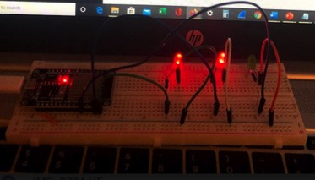
3-light Breadboard Layout
Challenges 1
The picture should show:
ESP32
Three LEDs
Three Resistors
Wires
As a challenge to add another LED light to the Light Control System

Slide 27
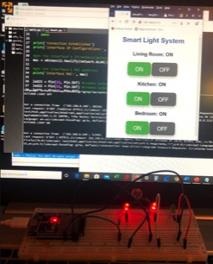
3-light Control
Web Interface
Challenges 1
The screenshot shows three sets of buttons to control three lights.
When pressing the On button on the phone or computer browsers the lights on the breadboard lit up as picture shows.

Slide 28
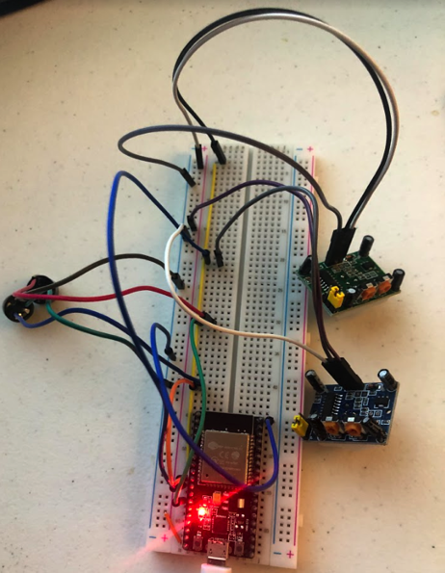
Two-alarm breadboard layout
Challenges 2
The picture show:
ESP32
Active buzzer
Passive buzzer
One or two motion sensors
Wires
The challenge is to add another motion sensor to detect motions and next slide shows the modified codes to run the project.

Slide 29
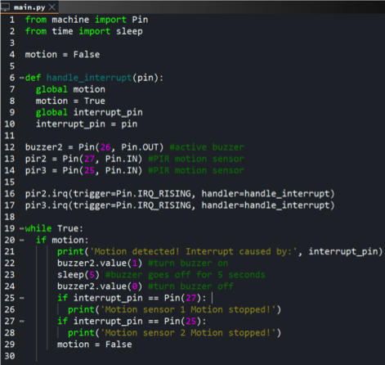
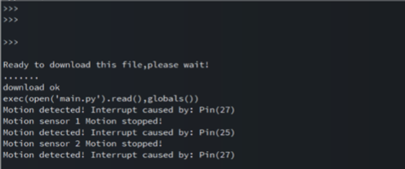
Two-alarm system output
Challenges 2
Modification to the codes to add another motion sensor.
Lined 14 shows Pin 25 was used for the other motion sensor.
Line 25 to 28 to indicate which sensor was activated and triggered the buzzer.
1. “xxxxx Motion detected” messages
2. Interruption sources
3. “xxxxx Motion stopped” messages

Slide 30
Career Skills Obtained
Python programming knowledge with electrical engineering skills to control hardware
Executing of different file encryption tool
Security Policy Writing Skills
Implementing Multi-Factor security with Google Authenticator
Nessus Vulnerability Assessment Skills
Network Administration Skill Programming Routers Ports
Wireshark Packet Analysis

