Slide 1

Fundamentals of Information
Technology & Networking II
NETW200
Hao Huang
April 2020

Slide 2
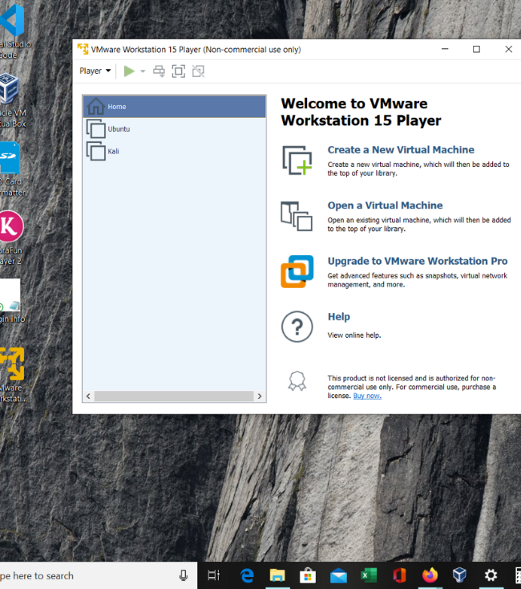
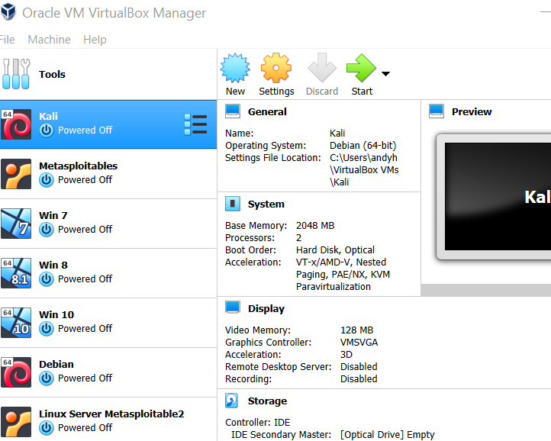
Import Kali Virtualized Appliance to VMware Player
I also tried the Oracle VM VirtualBox to compare performance, to my surprise that some tools do not run well in each version!

Slide 3
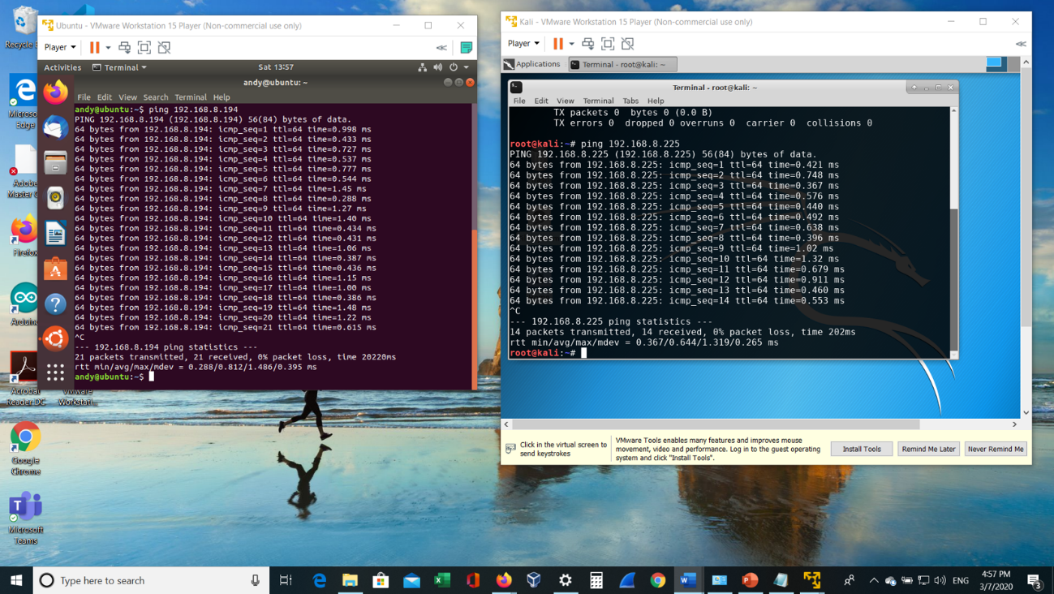
Successful ICMP Ping between Kali and Ubuntu VMs
Bridging the Kali’s virtual network adapter with the router to obtain IP for the virtual machines
Ping results show 0 packet loss means that physical device able to communicate with virtual machines

Slide 4
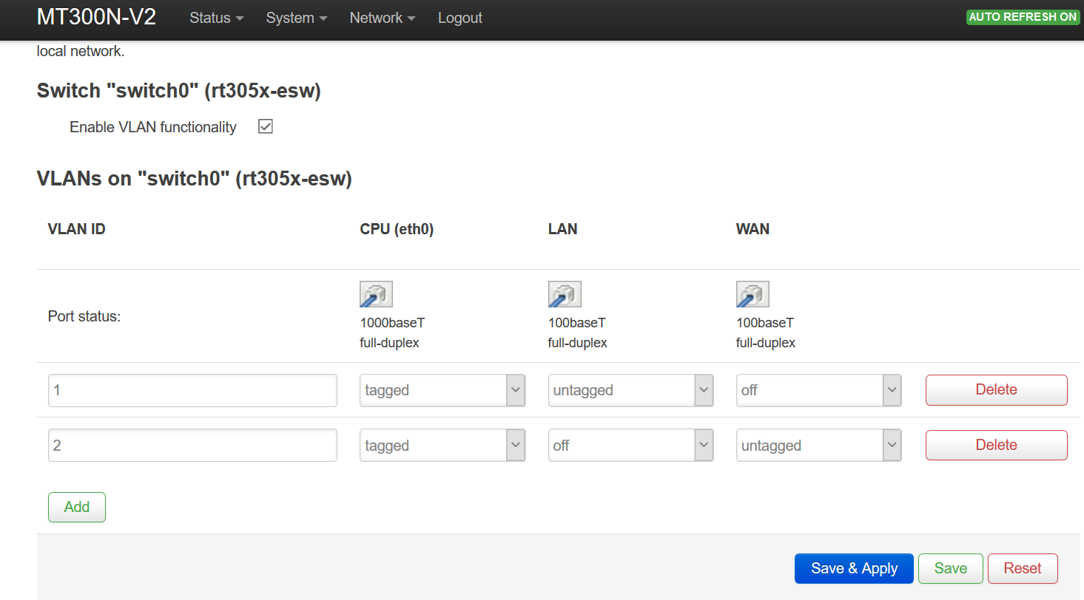
Configured VLANs on the Travel Router
GL-MT300N-V2
Learn how to create subnets
The significance of tagged network is that when there are multiple VLANs on any single port, the standard requires that the port must be tagged in each VLAN so the traffic can be distinguished.
Network Address | 1st usable address | Last usable address | Broadcast address
192.168.1.0 | 192.168.1.1 | 192.168.1.62 | 192.168.1.63
192.168.1.64 | 192.168.1.65 | 192.168.1.126 | 192.168.1.127
192.168.1.128 | 192.168.1.129 | 192.168.1.190 | 192.168.1.191
192.168.1.192 | 192.168.1.193 | 192.168.1.254 | 192.168.1.255

Slide 5
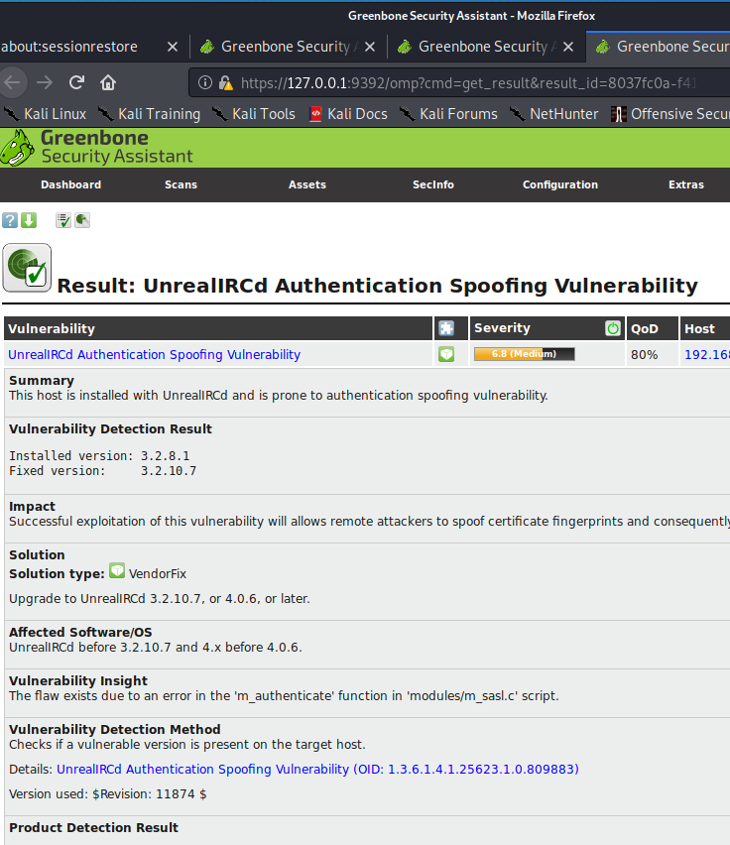
OpenVAS
Checking system vulnerabilities with severity levels and its detailed analysis
Low
Medium
High

Slide 6
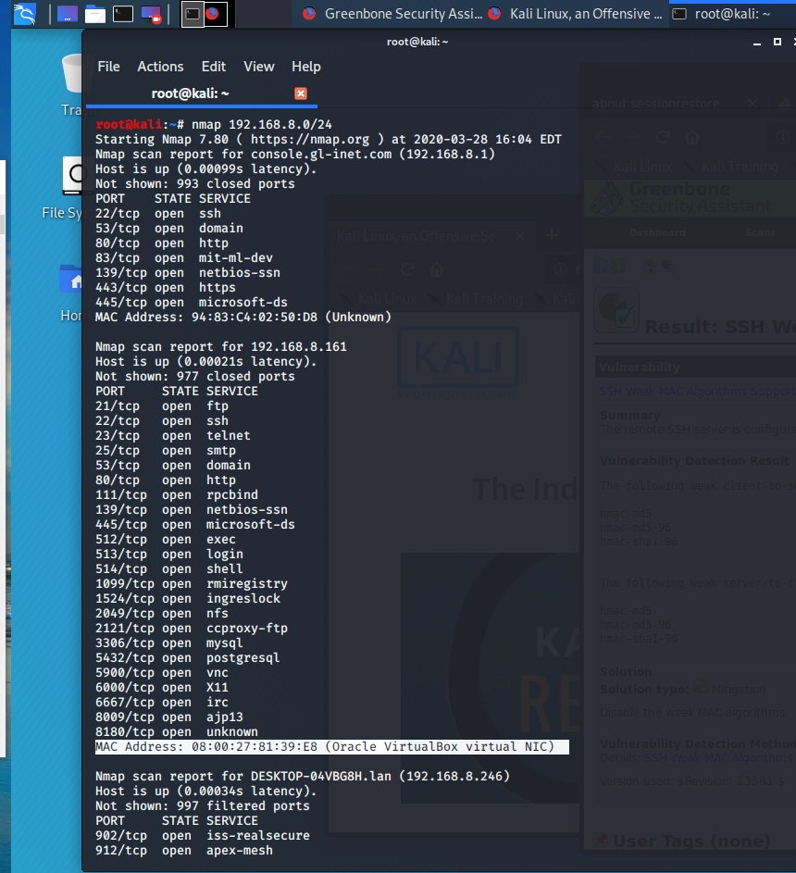
NMAP
Finding open ports and detecting security risks of a system or IP
Open ports
can be exploited!

Slide 7
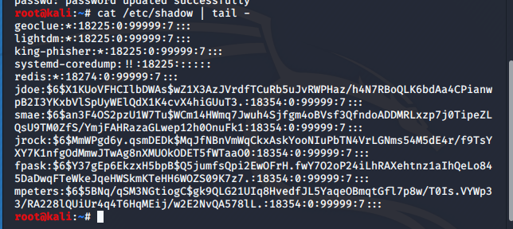
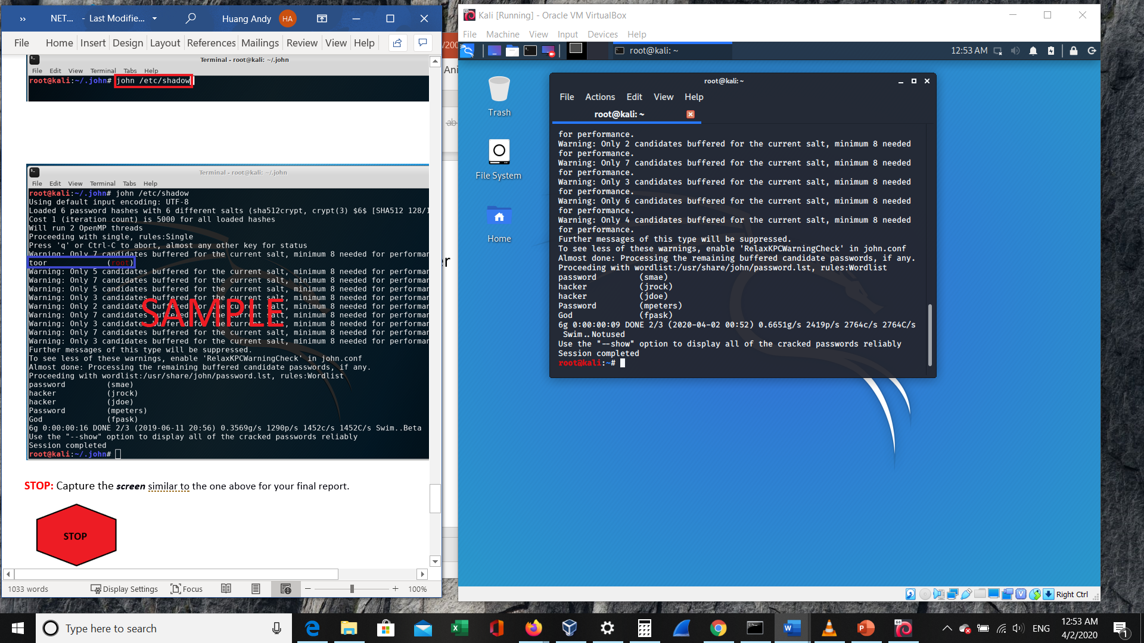

Screenshots of the encrypted passwords and cracked passwords by using John the Ripper security tool
John The Reaper

Slide 8

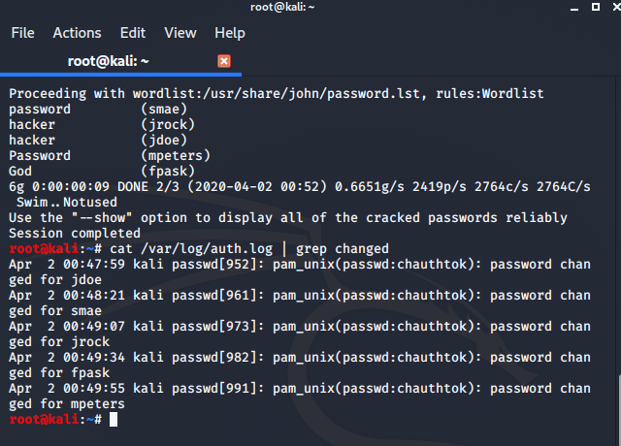
Authentication Logs
(auth.log)
To identify and provide information about users suspected of improper modification of access privileges or data such as:
Failed login attempts
Brute-force attacks

Slide 9
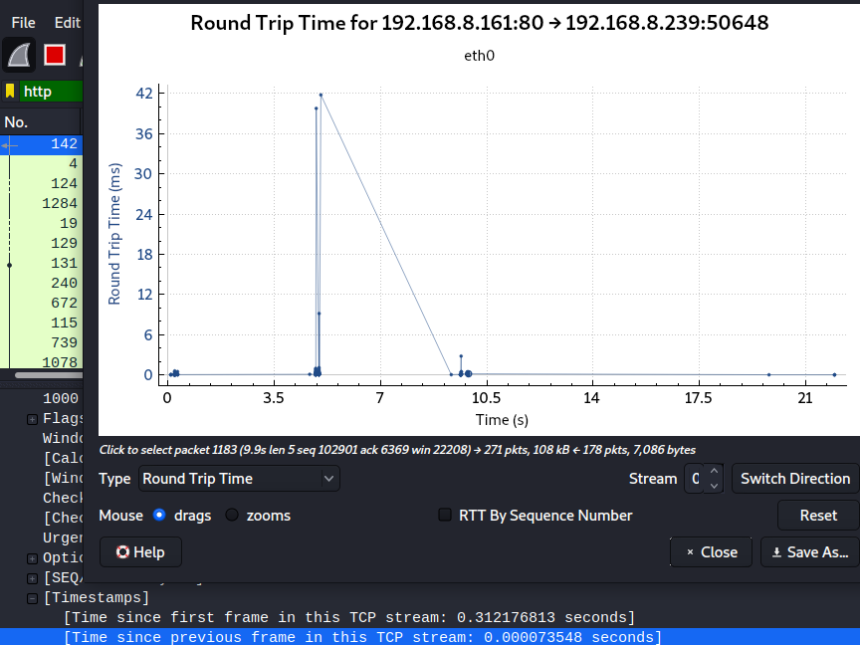
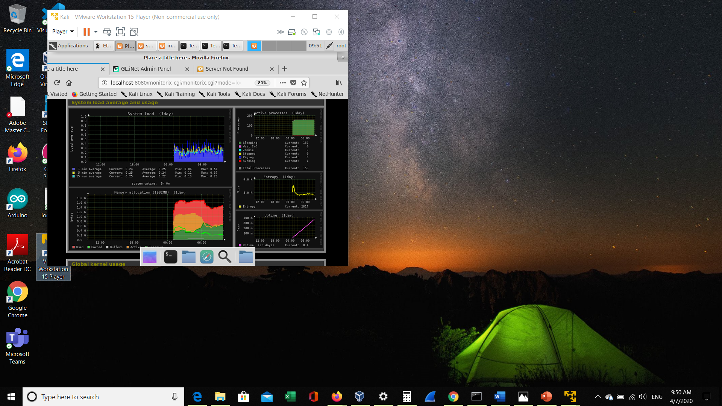
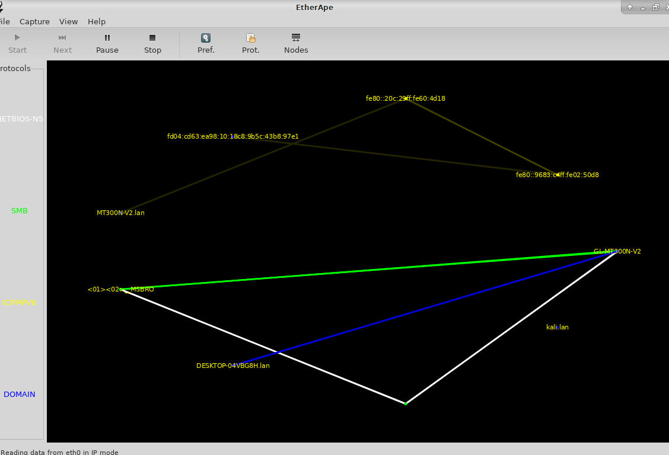
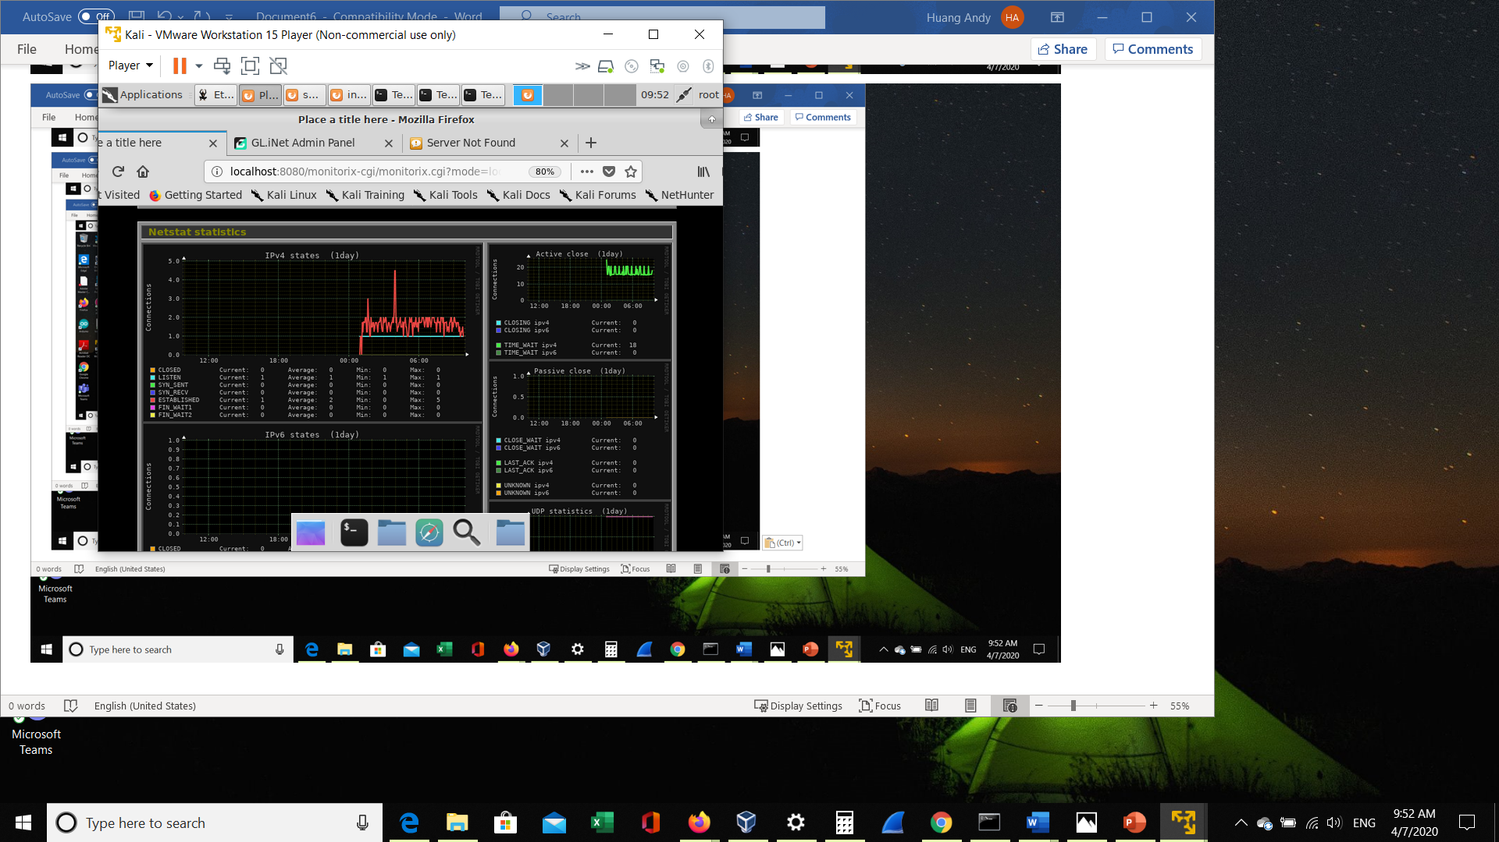
Graphical representation of changes Δ as network traffic goes in and out of the network card
Wireshark
Monitorix
Etherape
Monitorix

Slide 10

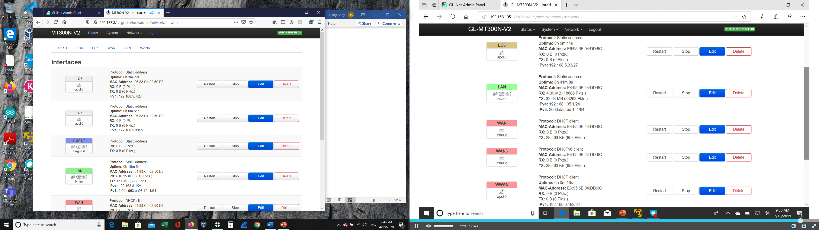
IP configurations of
Lo5 and Lo6 interfaces
A screenshot of Loopback 5 and Loopback 6 interfaces on the GL-MT300N-V2 Router.

Slide 11
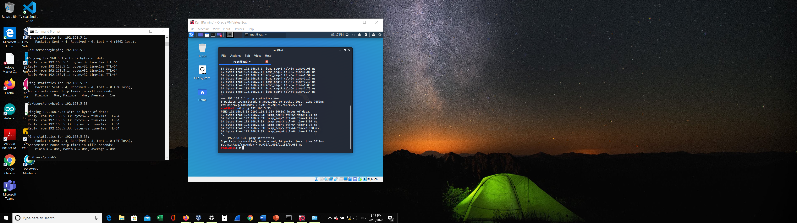
A screenshot of the ICMP Ping Test from the Kali Virtual Machine and two Loopback interfaces
A screenshot of the ICMP Ping Test from the Windows Host Computer and the two Loopback interfaces.

Slide 12
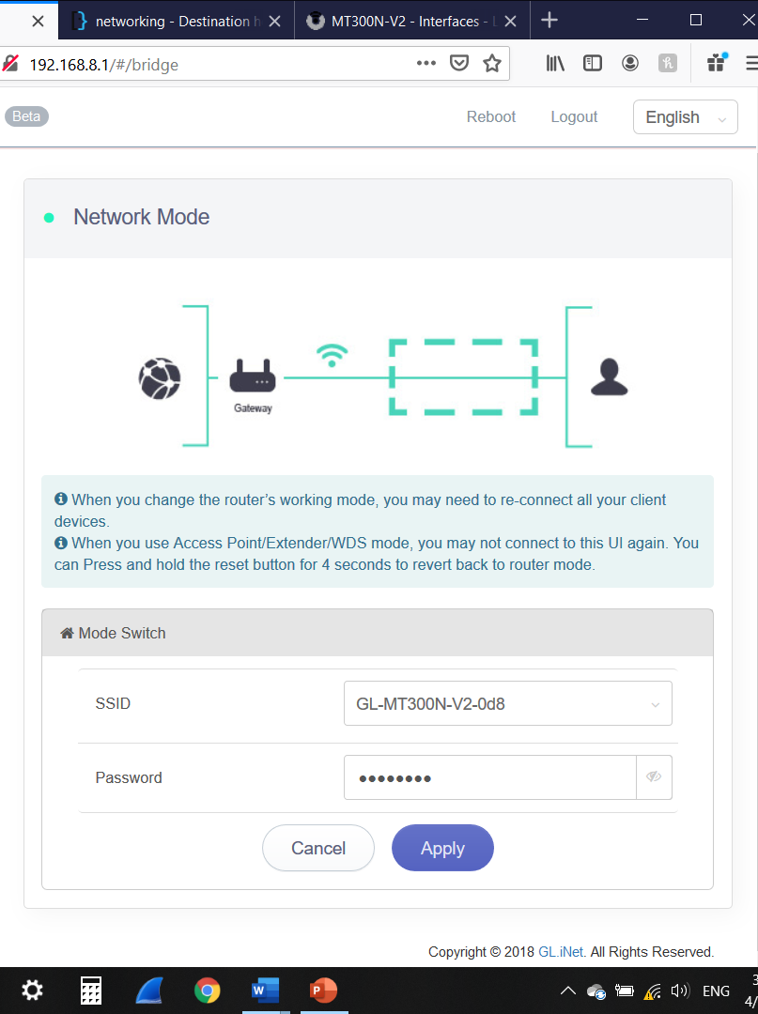
WLAN SSID
A screenshot of my WLAN SSID shown in the extender configuration window on the AR-750 router

Slide 13
Questions
1. What is the difference between a physical interface and a loopback interface?
A loopback interface is virtual interface to emulate a physical interface.
Virtual interfaces are network interfaces that are not associated with a physical interface. Physical interfaces have some form of physical element—for example, an RJ-45 male connector on an Ethernet cable. Virtual interfaces exist only in software; there are no physical elements.
2. How is it possible to successfully conduct an ICMP Ping test from Host Computer to the Loopback interfaces without the need for dynamic or static routing?
When the Kali host sent the ping request to destination network IP address, the request will first to be sent to the router or access point. The router served as the default gateway then forwards that ICMP ping packet to the destination IP address. Since the destination network IP address is being configured as subnet on the same router, the router acknowledges the packet is received and sent back to the Kali host that the destination subnet IP has received the packet.

